Slide 1
Project planning of Humble abode
CSE516 – Software Engineering and Design Pattern Lab
Group # 8
ID :
177701021–- Nishat Soultana Chy
17701067 - –Saima Akter Afrin
17701083 - – Fairooz Azim
17701088– - Sadia Sharmin
17701103 - –Maharun Nessa Meem
Course Instructor : A. H. M. Sajedul Haque Assistant Professor Department of CSE University of Chittagong

Slide 2
Introduction:
The system, “humble abode” is a solution:
-To find a suitable house to buy, rent or live temporarily.
-It helps the house owners to advertise their house for sell.
- To find skilled moving service.
- To find cleaning service easily.
-To find available interior designers.
-To find furniture and accessories shops.
**We only have five months and fifteen days remaining
**Our budget to finish the project is 2,00,000 TK

Slide 3
Development team
Project manager : 1. Nishat soultana chy
Analyst: 1.Fairooz Azim
2.Saima Akter Afrin
3.Nishat Soultana Chy
Designer: 1.Saima Akter Afrin
2.Sadia Sharmin
3.Maharun Nessa Meem
Programmer: 1. Nishat Soultana Chy
2. Fairooz Azim
Tester: 1. Sadia Sharmin
2. Saima Akter Afrin
3. Maharun Nessa Meem

Slide 4
Risk analysis
Risk no | Risk Name | Risk Type | Probability of the risk | Effect of the risk | Prevention/solution
01 | Used hardware are of bad quality or damaged | Technology Risk | Moderate | Serious | Providing best quality hardware with guarantee
02 | Database doesn’t process as fast as expected | Technology Risk | Low | Tolerable | Providing professional database system software
03 | Human errors | People Risk | Low | Catastrophic | By solving these errors
04 | Failure in commitment | People Risk | Moderate | Serious | Trying to adhere to the commitment
05 | Slow management cycle | People Risk | High | Tolerable | Increasing the motion of management cycle by all possible way
06 | Lack of testing | People Risk | Moderate | Serious | By testing different sector
07 | The software tools doesn’t work well | Tools Risk | Moderate | Serious | Avoiding that tools
08 | Lack of analysis for change of requirements | Requirement Risk | Moderate | Serious | Always get concerned about client’s requirement
09 | Inadequate of requirements | Requirement Risk | Very Low | Serious | Avoiding that types of requirements & try to replace these by better one
10 | Lack of Good Estimation in projects | Estimation Risk | High | Serious | By studying enough about the project
11 | Failure in total budget | Estimation Risk | Low | Tolerable | Successful budget management

Slide 5
Hardware Requirement
Serial no | Item | Quantity
01 | Personal Computer (Intel Core i3, 4GB RAM ) | 5
02 | Keyboard | 5
03 | Mouse | 5
04 | Local area network Connection | 5
05 | Android Device | 5

Slide 6
Software Requirement
Serial no. | Software name
01 | Windows 8\10 Operating System
02 | Android Studio 2.2.2.0/3.1
03 | Photo editor
04 | Microsoft office(word,Project)
05 | Firebase
06 | JDK 8

Slide 7
Work Breakdown
Serial No | Task or Milestones | Description
01 | T1 | Meeting with stakeholders on functions and constrains
02 | T2 | Finding & analyzing functions and constrains
03 | T3 | Meeting on validation functions and constrains
04 | M1 | Completion of requirement analysis
05 | T4 | Designing basic architecture of the system
06 | T5 | Designing activities and views
07 | M2 | Completion of application design phase
08 | T6 | Completion of application design phase
09 | T7 | Data collection and entry
10 | M3 | Completion of data entry process
11 | T8 | Implementing activities and views
12 | T9 | Establishing relation between data and views
13 | M4 | Completion of implementation of basic structure
14 | T10 | Implementing functions
15 | T11 | Integrating all parts
16 | M5 | Completion of development process
17 | T12 | Testing and debugging the system
18 | T13 | Deploying the system to the stakeholders
19 | M6 | Completion of the project

Slide 8
Deliverables
)
Software Requirement Specification Document (SRS)
Detailed Design Document (DDD)
Final Report on the Project
Source Codes

Slide 9
Project Schedule
Serial No | Task | Effort(person-days) | Duration(days) | Dependencies
01 | T1 | 1 | 5 | ----
02 | T2 | 2 | 8 | T1
03 | T3 | 3 | 3 | T2
04 | T4 | 2 | 10 | T3(M1)
05 | T5 | 2 | 8 | T3(M1),T4
06 | T6 | 3 | 8 | T3(M1)
07 | T7 | 3 | 14 | T6
08 | T8 | 2 | 8 | T5(M2)
09 | T9 | 3 | 8 | T7(M3),T8
10 | T10 | 3 | 50 | T3(M1),T5(M2),T7
11 | T11 | 3 | 7 | T6,T8,T10
12 | T12 | 3 | 15 | T11(M5)
13 | T13 | 2 | 6 | T12

Slide 10
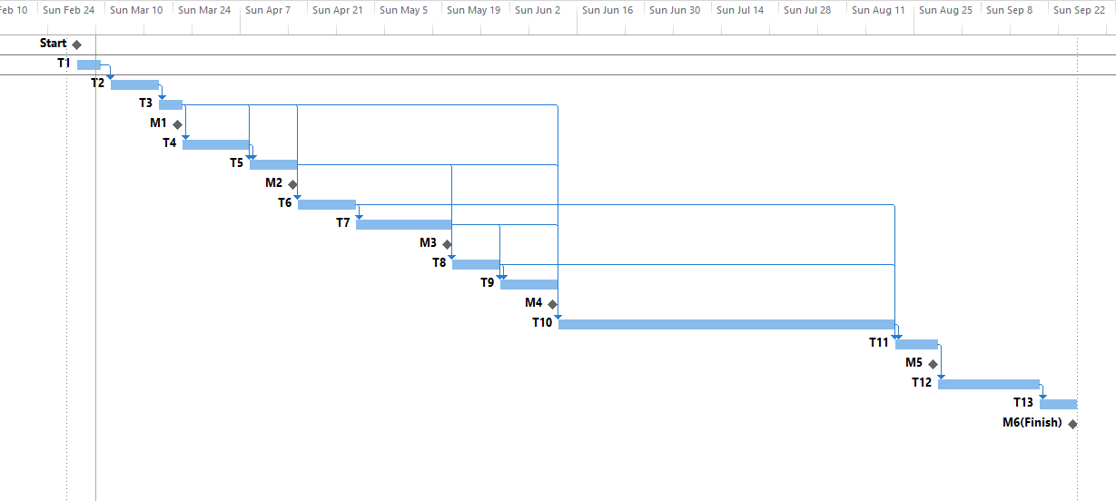
Activity chart:

Slide 11
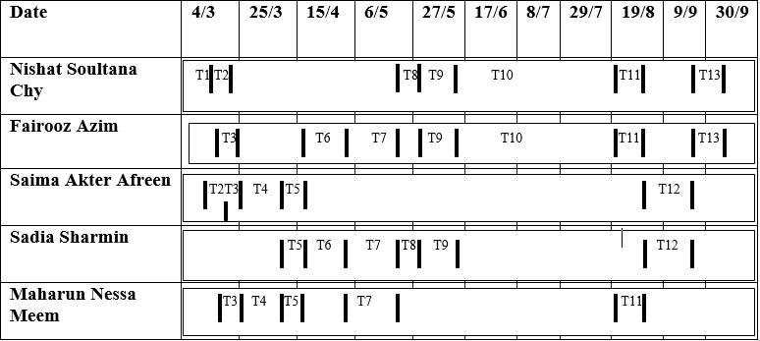
Member allocation:

Slide 12
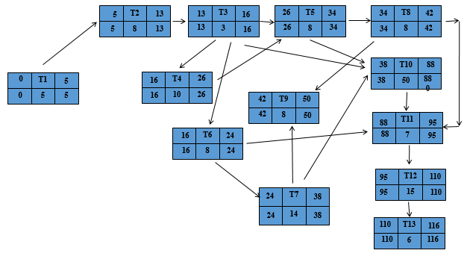
Activity network

Slide 13
Monitoring and Reporting Mechanisms
Daily Monitoring
Weekly Monitoring
Monthly Monitoring
Task Completion Reporting
Milestone Completion Reporting

Slide 14
Estimated project monitoring
Task | Effort(person) | Duration(Day) | Working State | Submission Date
Problem Definition Document(PDD) | 5 | 7 | Done | 17.02.19
Feasibility Study Report | 5 | 7 | Done | 24.02.19
Project Planning | 5 | 14 | Done | 10.03.19
System Requirement Specifications | 5 | 14 | Not Yet Done | -
System design Document | 5 | - | Not Yet Done | -
Implementation | 5 | - | Not Yet Done | -

Slide 15
Thank You!

